Slide 1

Providing hands-on experience in finance for students

Slide 2





Education
Expand your knowledge of finance and enhance your soft skills.
Practice
Get experience in investing in stocks, no own money required
Community
Join our family of like-minded and driven students and alumni.
WHAT WE OFFER
Leadership
Fulfill your leadership potential in one of our internal departments.
Network
Grow your network and connect with our industry-leading sponsors.

Slide 3














OUR SPONSORS
EGERIA

Slide 4
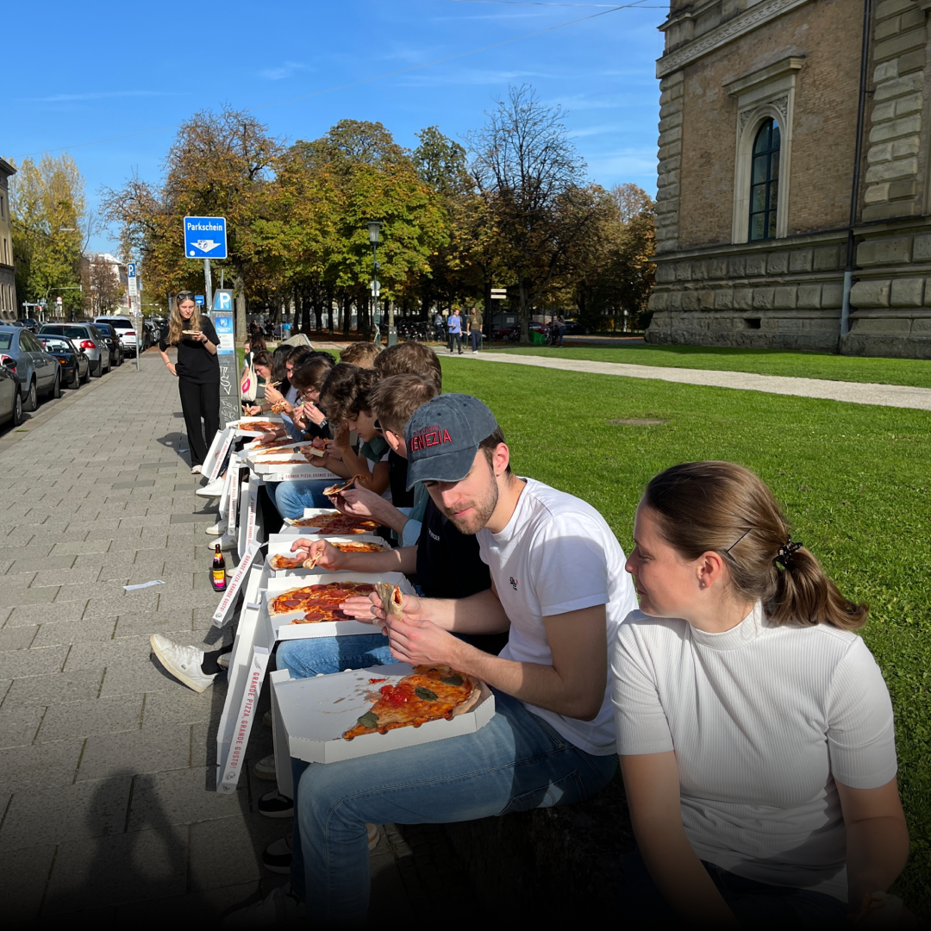
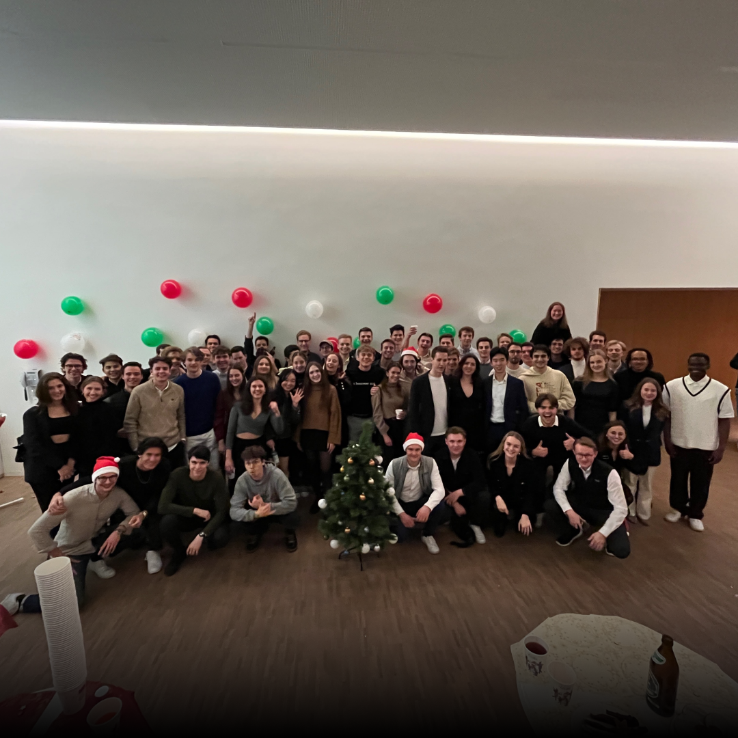
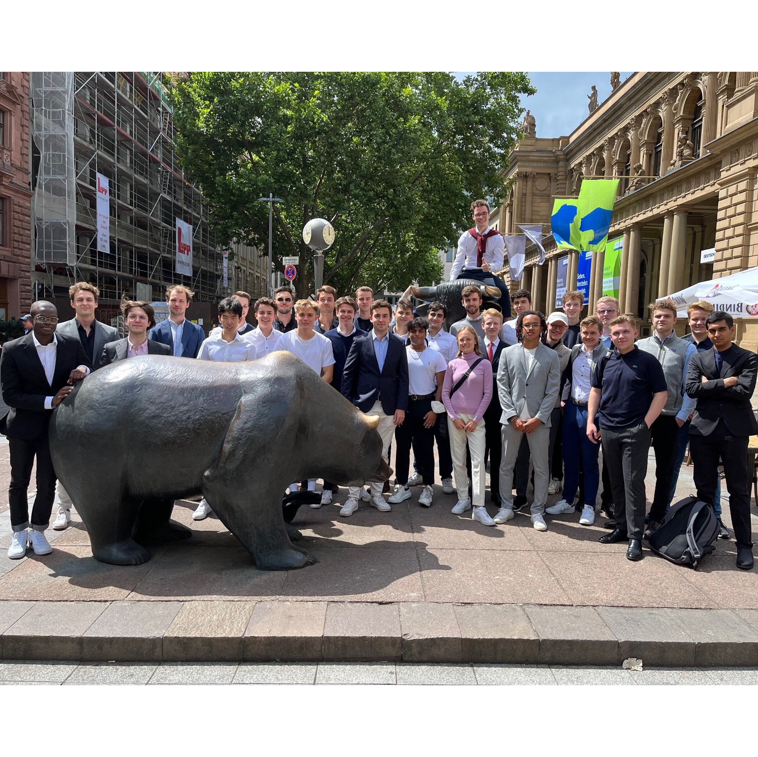
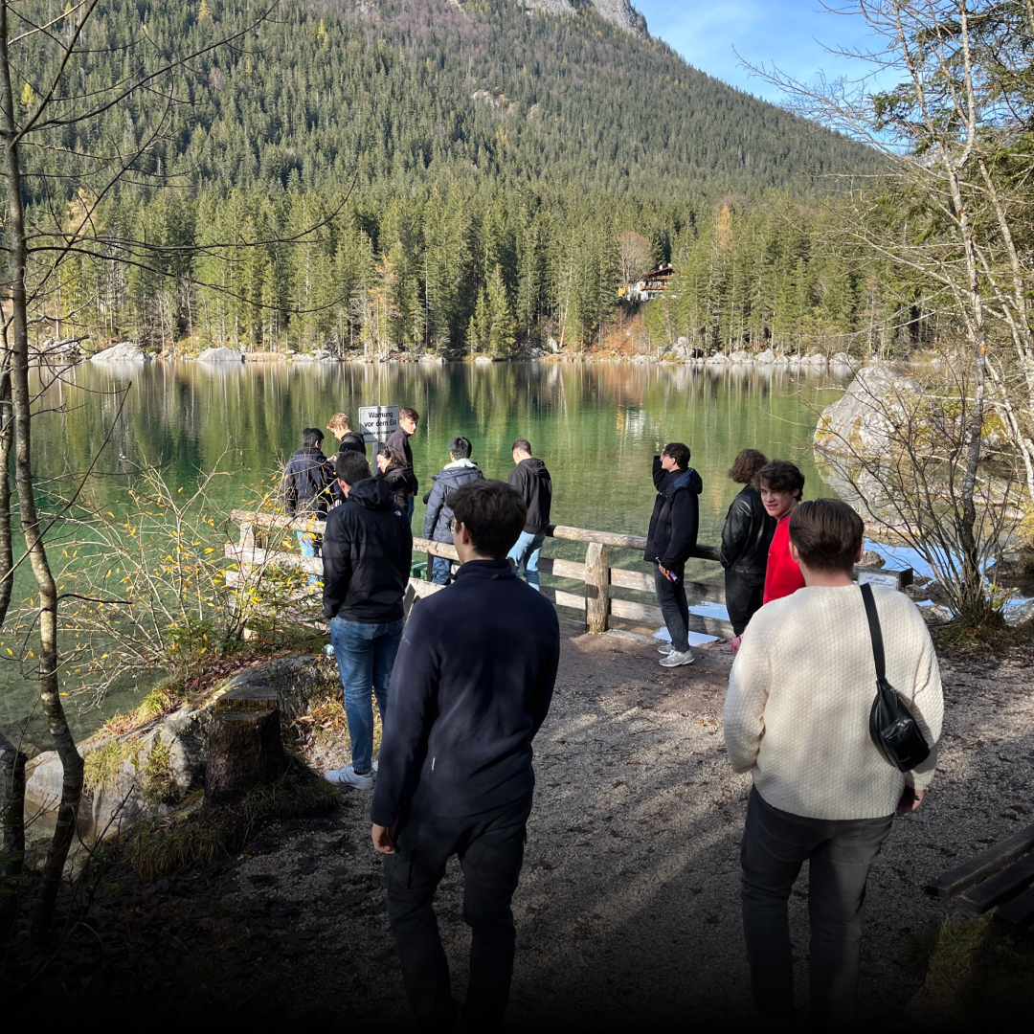
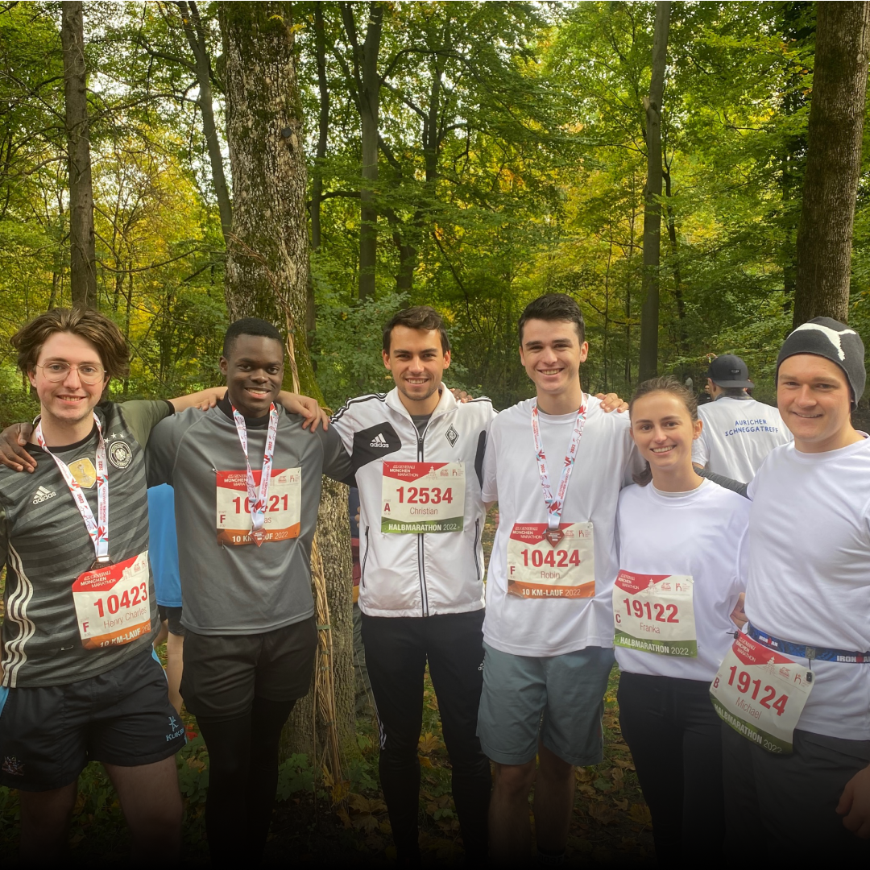
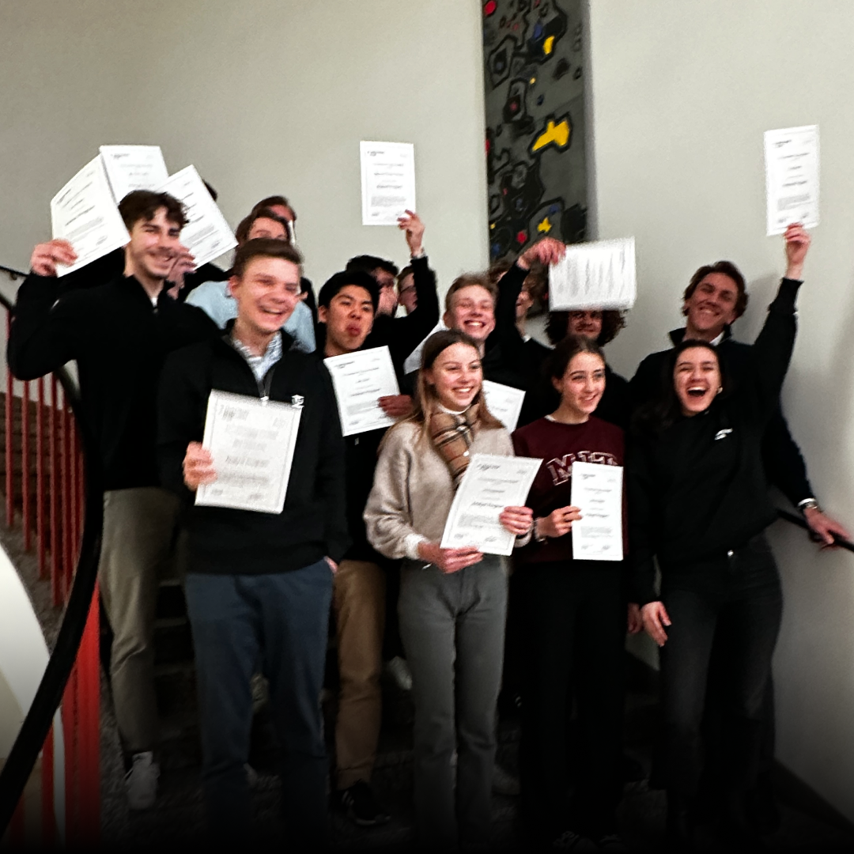
OUR COMMUNITY

Slide 5

Recruiting Start!
Apply until 03.11!!
16.10
Women in Finance Events
Networking (18.10)/CV & Interview Workshop (30.10)
18.10/30.10
Info Sessions
Online (19.10)/In-Person @TUM-1237 (24.10)
19.10/24.10
IMPORTANT DATES
Introduction to Spring Weeks (Online)
Registration through our Website!
21.10
Student Initiatives Fair - Garching
25.10
26.10
Bank of America Event
Apply until 18.10 – EOD!

Slide 6
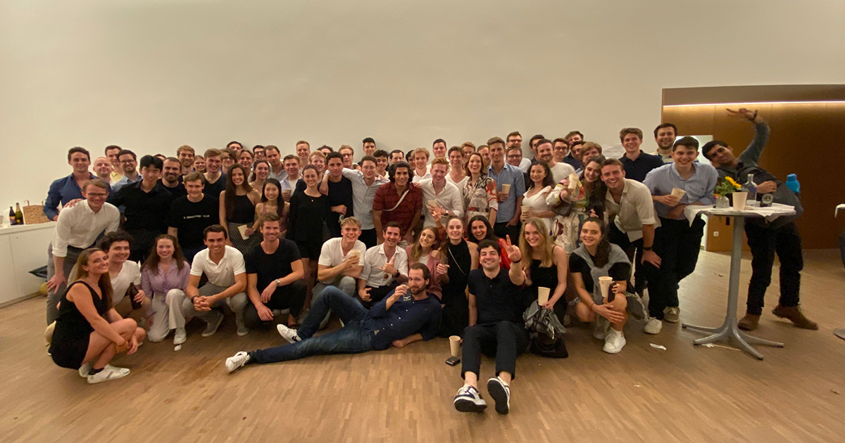


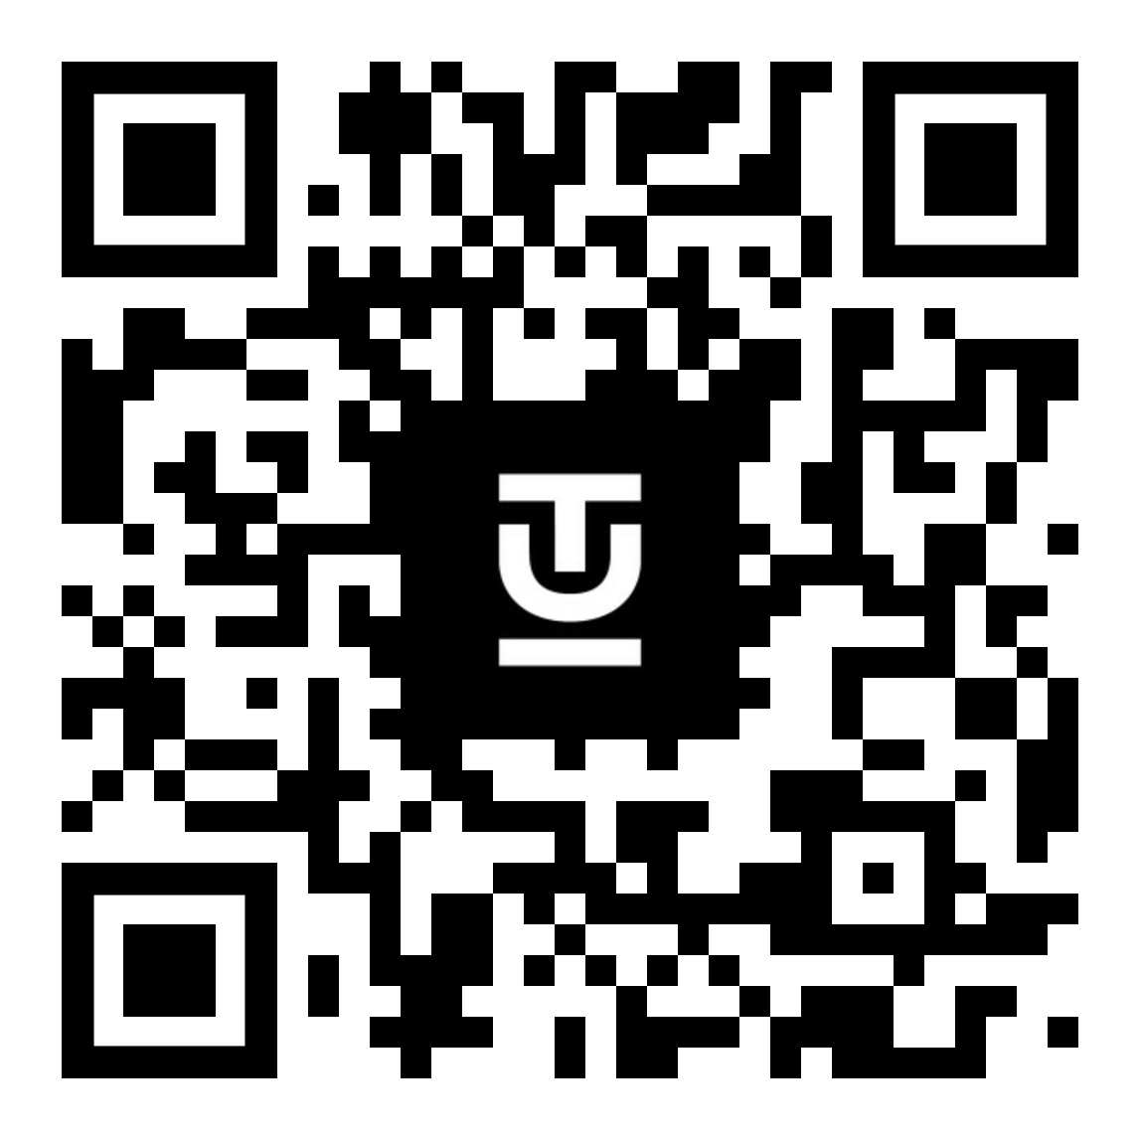
We look forward to connecting with you & to your application!
Follow us on social media:
@tuinvestmentclub
@TU Investment Club e.V.
Apply online:
Application Deadline: 03.11.2023 – 12pm

Slide 7
THANK YOU

